Slide 1
ICT & Software Engineering
02 – Windows Forms APP
Introduction windows forms & C#

Slide 2

Content
Topics of this lecture
Introduction to Windows Forms App
Basic controls
Styling
Formatting strings
Variable scope

Slide 3
Windows forms App
Visual studio project type

Slide 4

Intro
Create visual desktop applications that users can interact with
Provide visual elements as a way to gather input from the user, as well as display output to the users.
Visual elements are called Controls
Examples: Button, TextBox, Label, etc.

Slide 5
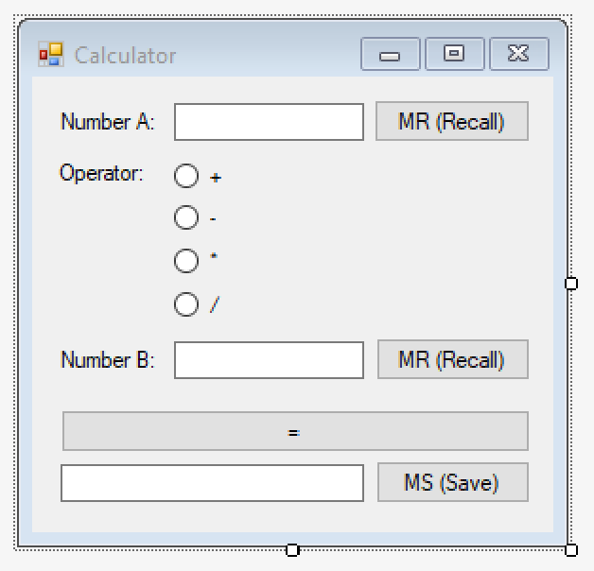
Intro: Example form

Slide 6
Windows forms app: Event-based
Code is executed when an event occurs on a form
Event triggered
Perform task
Show Output
Handle error

Slide 7
Examples (1/2)
Task: Perform addition operation for inputted numbers
Button is clicked
Numbers are retrieved from the two TextBoxes and added together
Show result in a Label
Show message that integers must be supplied

Slide 8
Examples (2/2)
Task: Prevent input of non-integer characters
Key is released when typing in a TextBox
Determine if the released key represents a non-integer character
Do nothing; character will be shown in TextBox
Prevent character from being shown in TextBox

Slide 9
How to create a Form
Visual studio

Slide 10

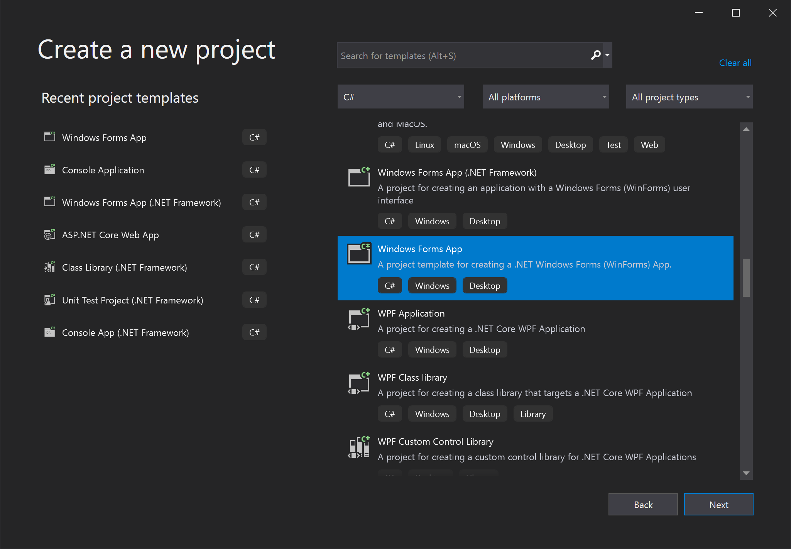
Guidelines – Create project (1/3)
Create a Windows Forms app (Create new Project or File -> New -> Project)
Language support
Type of the visual studio project

Slide 11
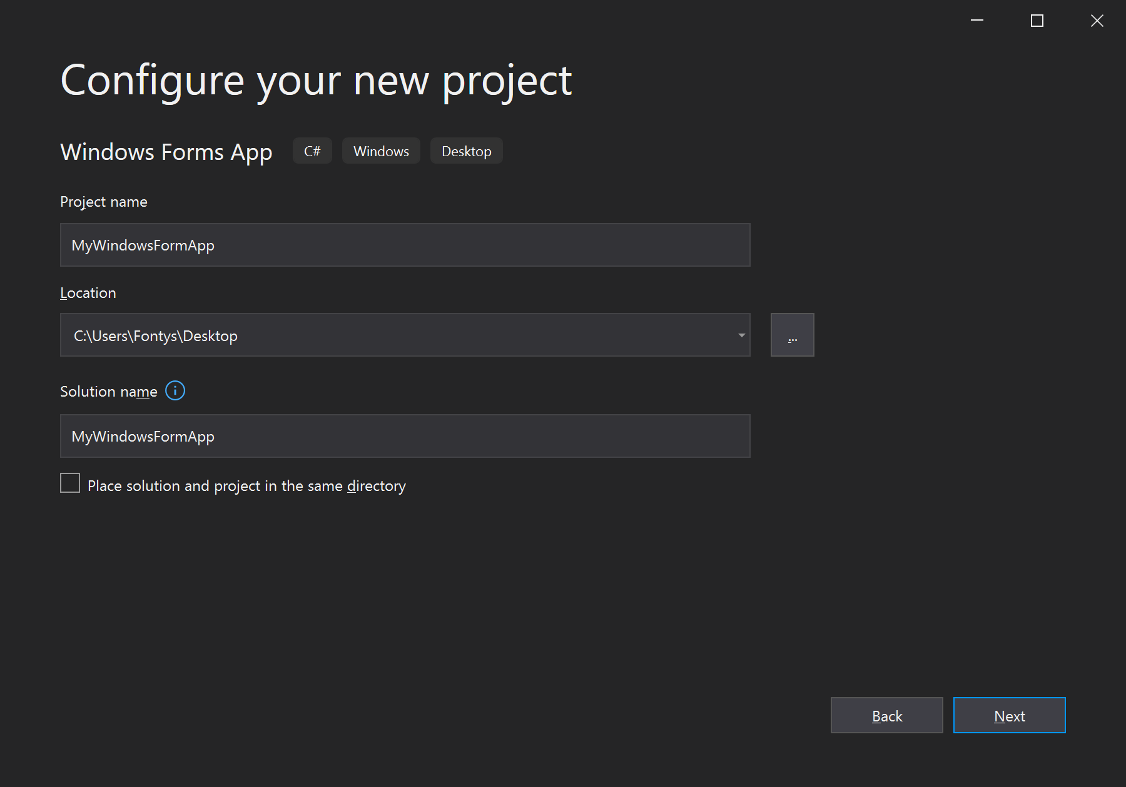
Guidelines – Create project (1/3)
Configure your Windows Forms app-project
Name for the project
Where the project will be created/saved
Name of the solution Change this when you work with multiple project

Slide 12
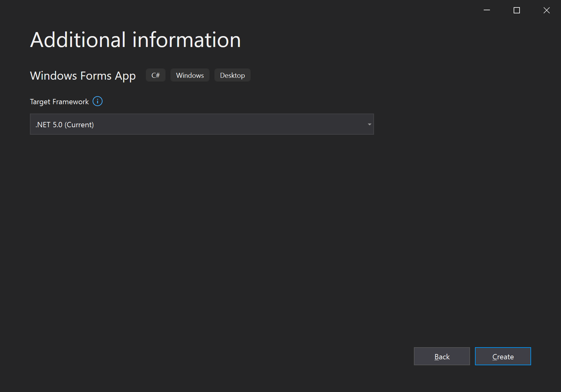
Guidelines – Create project (1/3)
Configure your Windows Forms app-project
Which version of .NET Framework to use Keep this as default/the most recent version

Slide 13
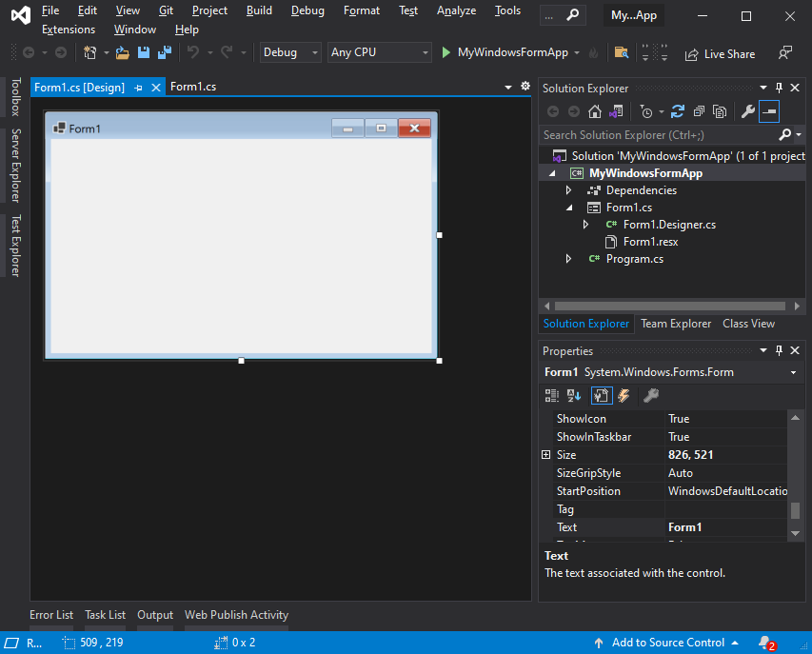
Guidelines (cont.)
Generated Windows Forms Application
Contents of your
solution
Empty Form
Properties of selected control – in this case, the Form (e.g. text, size, background color)

Slide 14
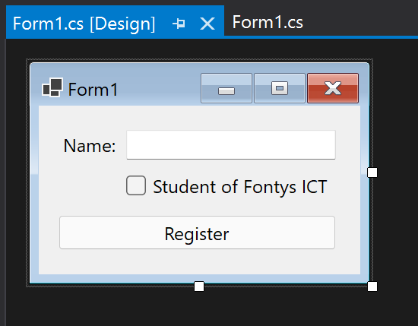
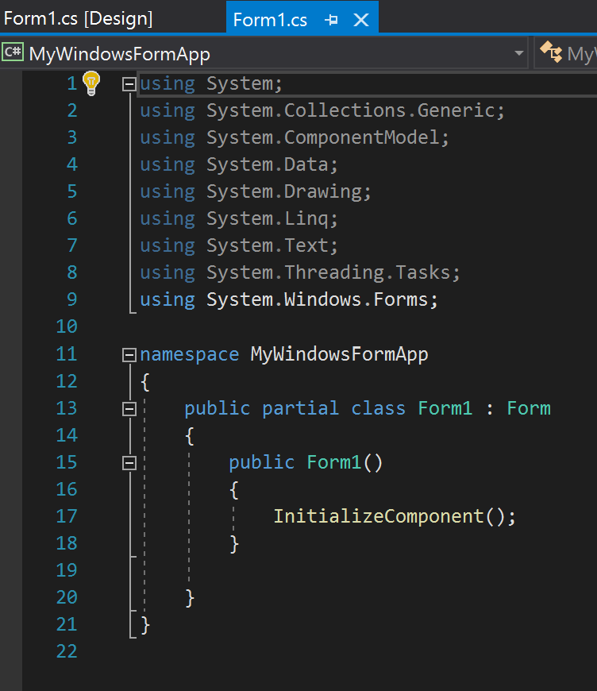
Terminology
Form
Form – Design view / Designer GUI editor
Form – Code view / code-behind Code editor
Controls label, textbox checkbox and button
C# Code A Class with constructor

Slide 15
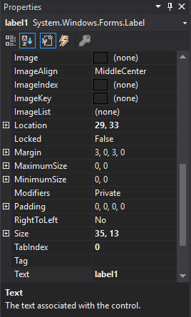
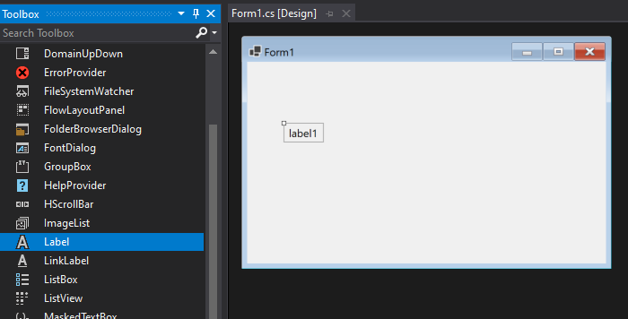
Information: Controls
Drag-and-drop a Control on the Form from the Toolbox
Access the Toolbox from View -> Toolbox
Available Controls
Drag-and-drop
Default properties of the selected Control – in this case, the Label

Slide 16
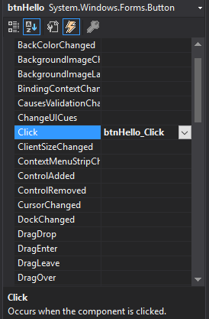
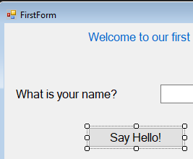
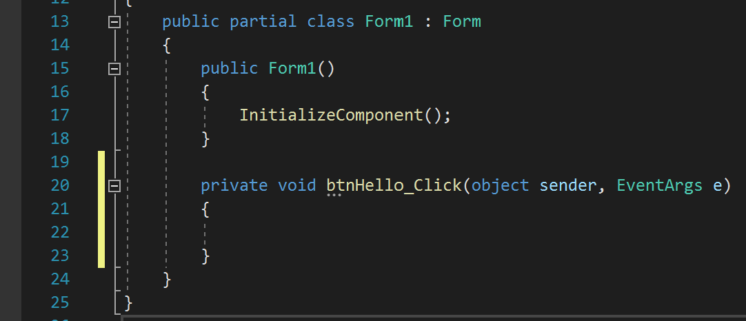
Information: Controls (cont.)
Allow behavior by adding an Event
Double-click
Button-control
Events of selected control

Slide 17


Demo
Create the first Windows Forms Application in Visual Studio.

Slide 18
Information: Controls(cont.)
The code that should be executed when the button is clicked goes in the EventHandler
private void btnHello_Click(object sender, EventArgs e)
{
//Code here gets executed everytime the button is clicked
}

Slide 19
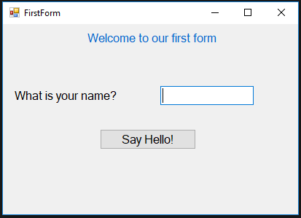
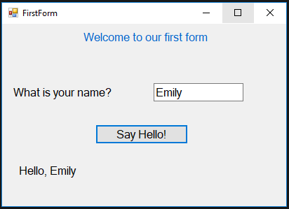
Your turn! (15 minutes)
Build this app:
Type a name,
then click the
button
Done? Refactor you code to only show Hello, <name> when a string is supplied. When nothing is inputted, show an appropriate message instead

Slide 20

Extra information
Give descriptive names to Controls, using a prefix to indicate the type of Control, followed by the purpose of the Control.
lblTitle
lblName
tbName
btnHello
lblResult

Slide 21

Questions?

Slide 22
Part 2 - Practical
See canvas for practical assignments

Slide 23
Content
Topics of this lecture
Introduction to Windows Forms App
Basic controls
Styling
Formatting strings
Variable scope

Slide 24
Questions?

Slide 25
Code styling
Code quality

Slide 26
Intro: Styling
How to improve readability of code for yourself/other developers?
Comments
Naming conventions
Space & indentation
Curly brackets
KISS

Slide 27

Examples
int monthsInYear = 12;
double bonusPercentage = 0.08;
double bonus = 0;
double monthlyIncome = Convert.ToDouble(tbMonthlyIncome.Text);
double holidayIncome = Convert.ToDouble(tbHolidayIncome.Text);
string getsBonus = tbBonus.Text;
double yearlyIncome = monthsInYear * monthlyIncome;
if(getsBonus == "yes")
{
bonus = yearlyIncome * bonusPercentage;
}
yearlyIncome = yearlyIncome + holidayIncome + bonus;
Bad vs Good
double a = Convert.ToDouble(textBox1.Text);
double b = Convert.ToDouble(textBox2.Text);
string c = textBox3.Text;
double d = 12 * a; double e = 0;
if(c == "yes")
e = d * 0.08;
d = d + e + b;

Slide 28
Extra information
Include single-line comments by using //
Include multiline comments by using /* … */
Follow naming conventions:
For now, lowercase names for variables
Also, camelCase for variable names
// this is a comment
/*
* This is a multiline comment
* Can be used for explaining the purpose of different elements
*/

Slide 29
String manipulation
Formatting

Slide 30
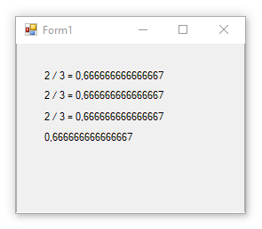
Formatting strings: several ways
double a = 2;
double b = 3;
label1.Text = a + " / " + b + " = " + a/b;
label2.Text = $"{a} / {b} = {a/b}";
label3.Text = string.Format("{0} / {1} = {2}", a, b, a/b);
label4.Text = (a/b).ToString();
Implicit conversion
Explicit conversion

Slide 31
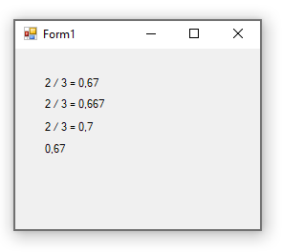
Formatting strings: fixing decimals
double a = 2;
double b = 3;
label1.Text = a + " / " + b + " = " + $"{a/b:f2}";
label2.Text = $"{a} / {b} = {a/b:f3}";
label3.Text = string.Format("{0} / {1} = {2:0.0}", a, b, a/b);
label4.Text = (a/b).ToString("0.00");

Slide 32
Questions?

Slide 33
Variables
Scope

Slide 34
Variable scope
The scope of a variable, sometimes referred to as accessibility of a variable, refers to where the variable can be read from and/or written to, and the variable's lifetime, or how long it stays in memory.
-MSDN
In general, a local variable is only available after declaration in the block of code in which it has been declared.

Slide 35
Variable scope: example
{
double a = Convert.ToDouble(tbInput.Text);
if (a != 0)
{
double b = 1 / a;
MessageBox.Show("1 divided by {0} is {1} ", a, b);
}
}

Slide 36
Variable scope: example
{
double a = Convert.ToDouble(tbInput.Text);
if (a != 0)
{
double b = 1 / a;
Messagebox.Show("1 divided by {0} is {1} ", a, b);
}
}

Slide 37
Variable scope: example
{
double a = Convert.ToDouble(tbInput.Text);
if (a != 0)
{
double b = 1 / a;
Messagebox.Show("1 divided by {0} is {1} ", a, b);
}
}

Slide 38
Practice Synthesis Concepts
Calculator with memory function

Slide 39

Summary
After this lecture you can:
Create a WinForms application
Display and retrieve information using Controls
Store and manipulate that information using variables
Write readable code

